Slide 1
Housing Price Project
Submitted By :
Faiyaz ansari

Slide 2
Problem Statement
Houses are one of the necessary need of each and every person around the globe and therefore housing and real estate market is one of the markets which is one of the major contributors in the world’s economy. It is a very large market and there are various companies working in the domain. Data science comes as a very important tool to solve problems in the domain to help the companies increase their overall revenue, profits, improving their marketing strategies and focusing on changing trends in house sales and purchases. Predictive modelling, Market mix modelling, recommendation systems are some of the machine learning techniques used for achieving the business goals for housing companies. Our problem is related to one such housing company. A US-based housing company named Surprise Housing has decided to enter the Australian market. The company uses data analytics to purchase houses at a price below their actual values and flip them at a higher price. For the same purpose, the company has collected a data set from the sale of houses in Australia.

Slide 3
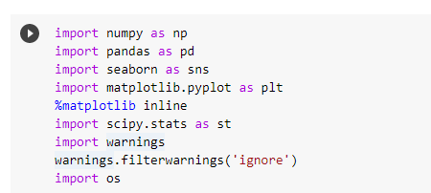
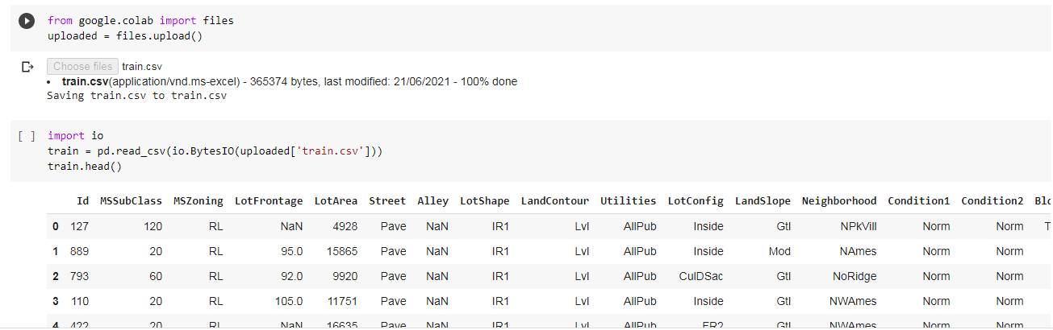
Importing necessary libraries and loading data set

Slide 4
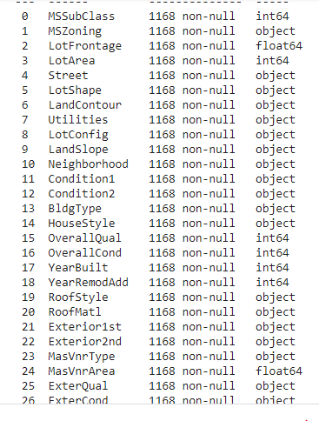
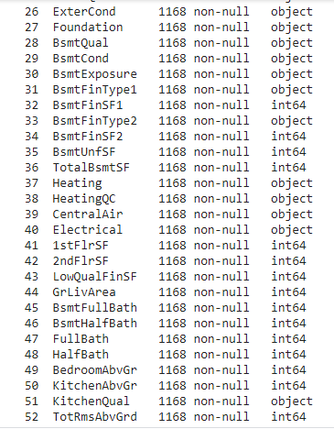
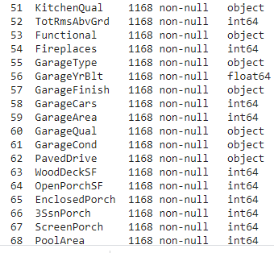
Lets see shape of dataset and check their datatypes

Slide 5
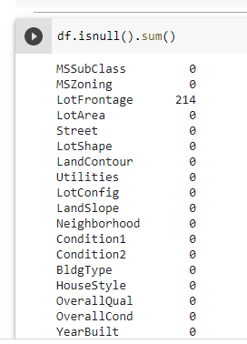
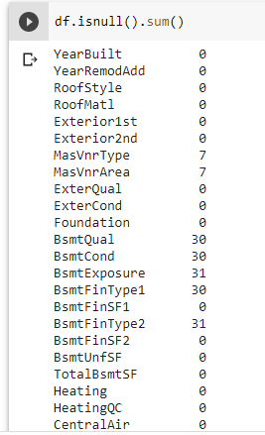
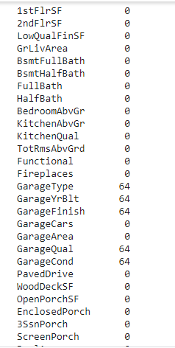
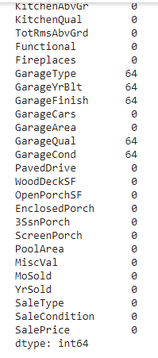
There are null values present in the dataset
Checking Null Values in the Dataset

Slide 6
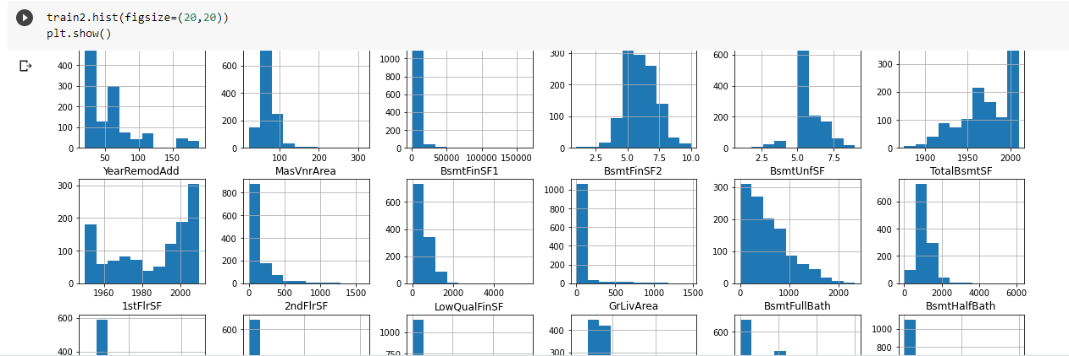
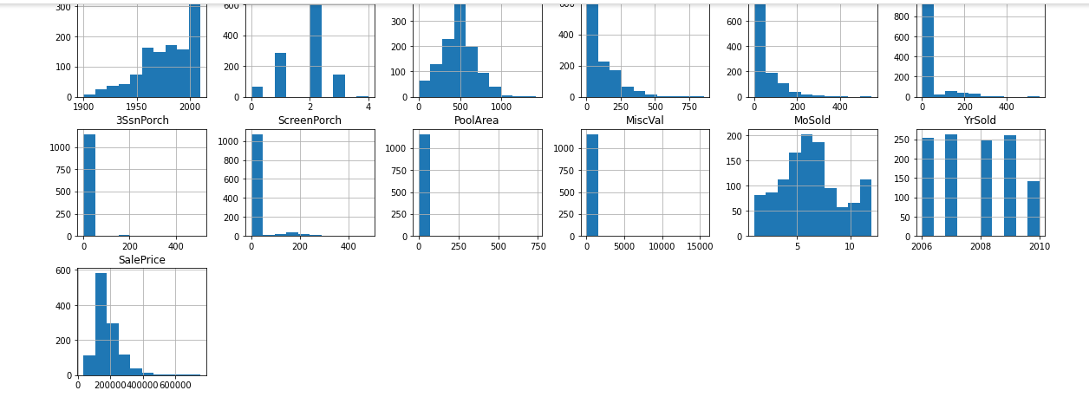
Data Visualization and Analysis

Slide 7
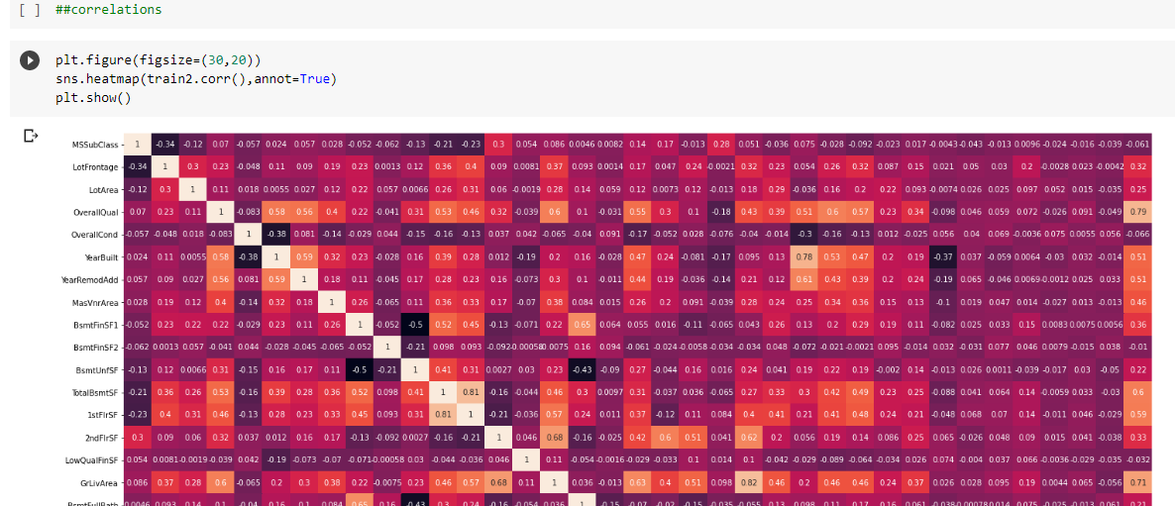
Correlation of variables

Slide 8
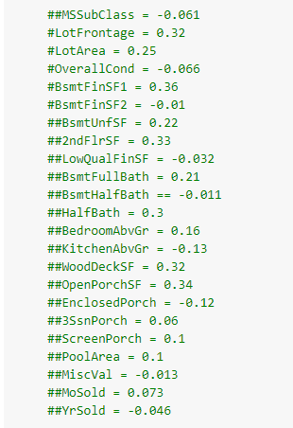

Least correlation with target variables
High correlation among independent features

Slide 9
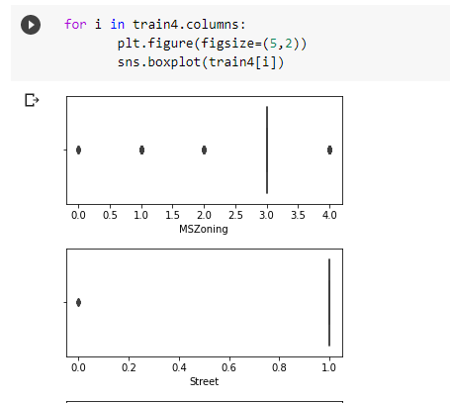
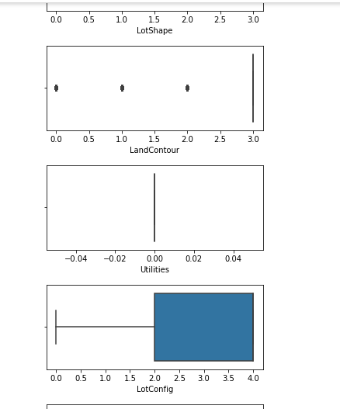
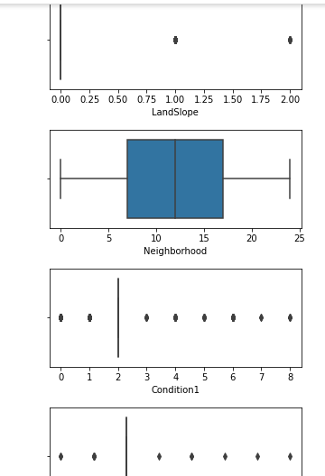
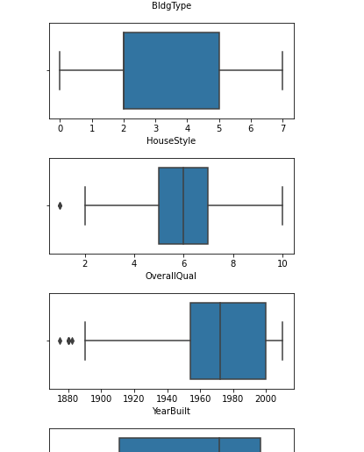
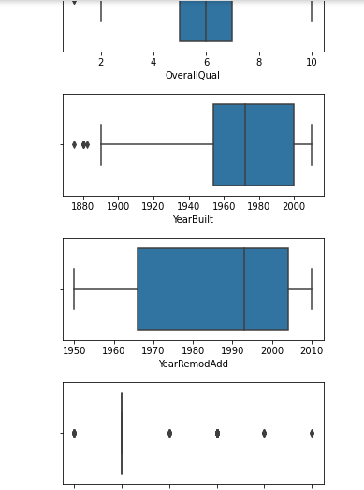
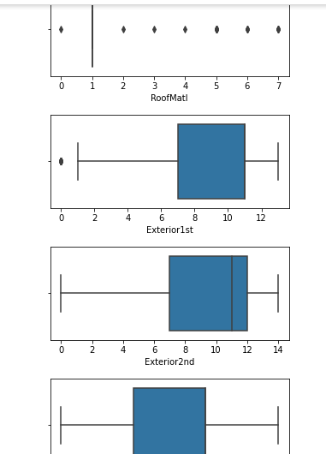
We can see that many outliers are present in the dataset. Further we will try to Reduce Outliers in the dataset

Slide 10

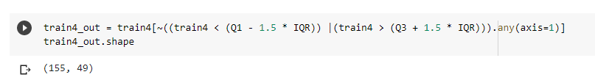
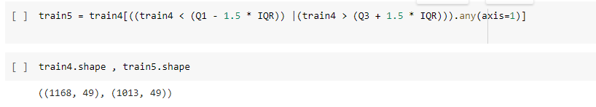
REMOVING OUTLIERS USING IQR
155 outliers are detected and then removed using the below code

Slide 11
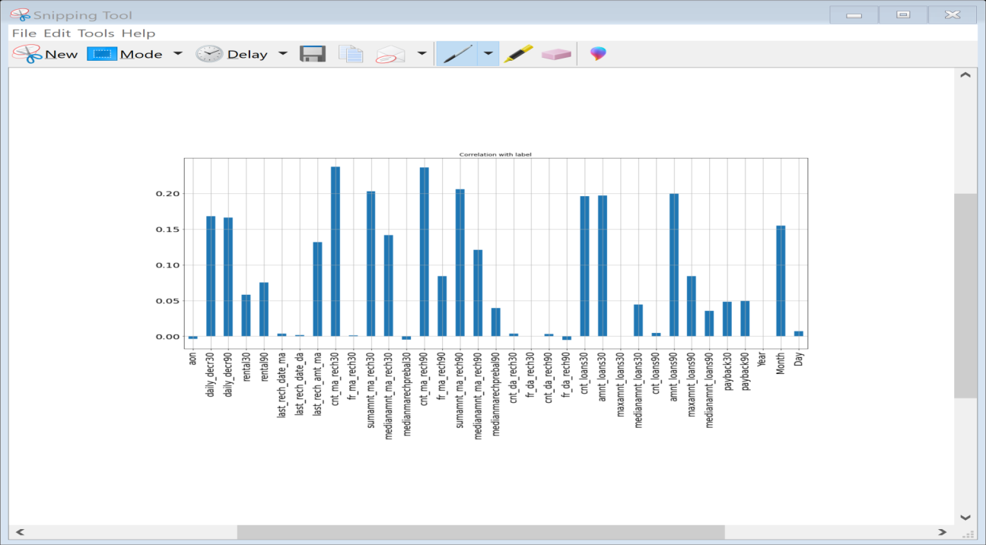
Co-relation with Target Variable Label
It seems from the above graph is that negatively correlated feature is age on cellular network in days, medianmarechprebal30, but we cannot blindly remove this feature because according to me it is very important feature for prediction. msisdn, year, pcircle and Frequency of data account recharged in last 30 days is unimportant and it has no role in prediction so we will remove it later.

Slide 12
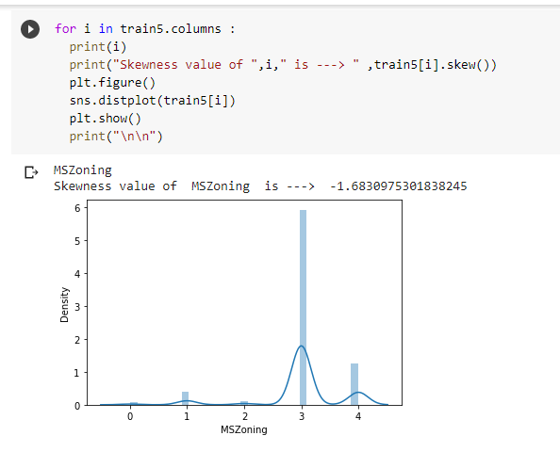
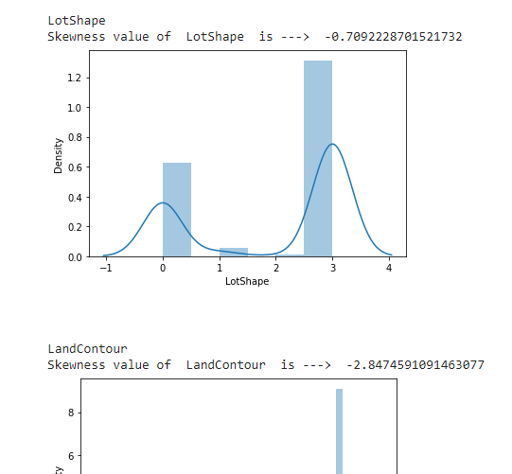
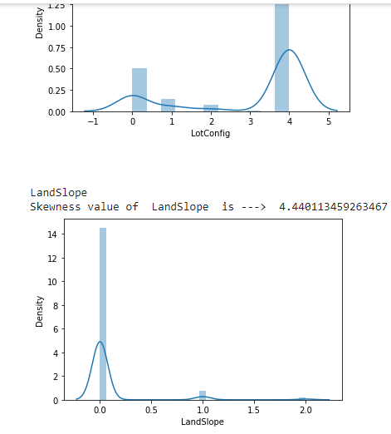
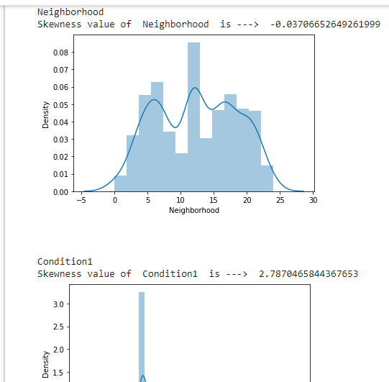
Plotting distribution plots to see the skewness in the features

Slide 13
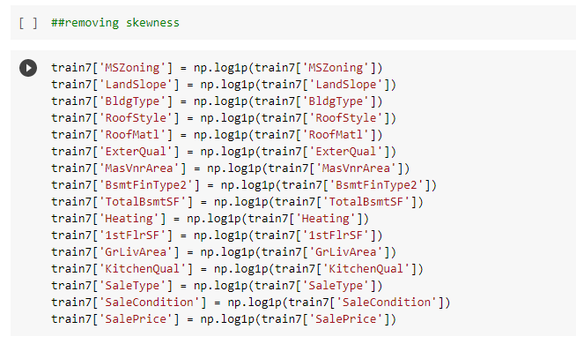
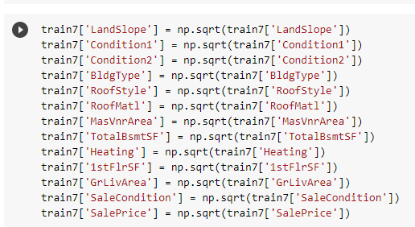
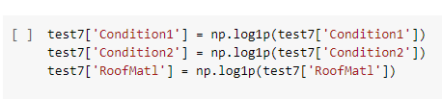
Removing skewness using transformations

Slide 14
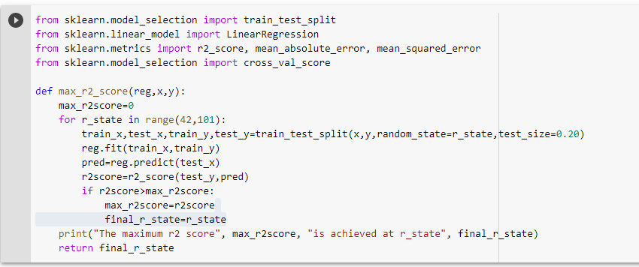
Splitting Data into Input and Output Variable
Below is the code to find the best random state.

Slide 15
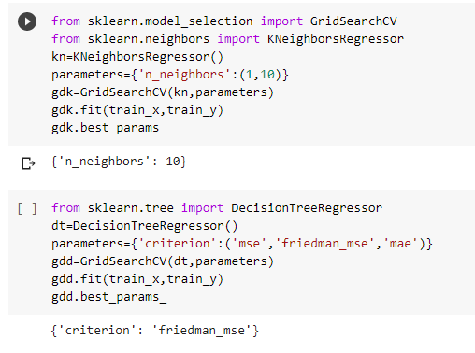
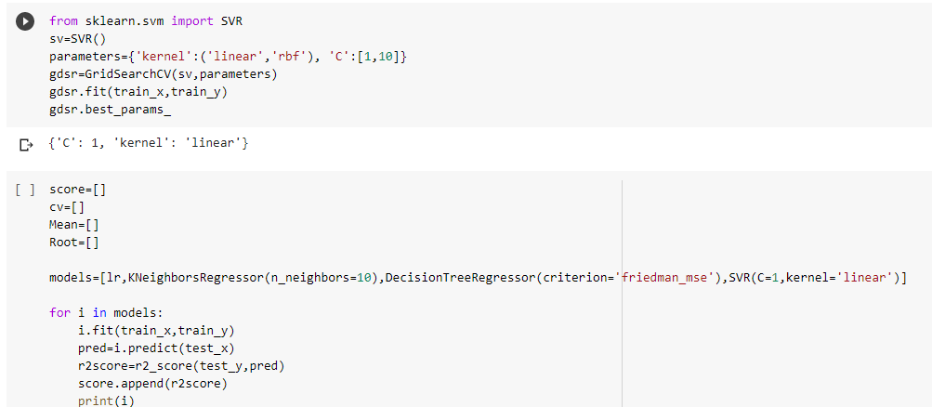
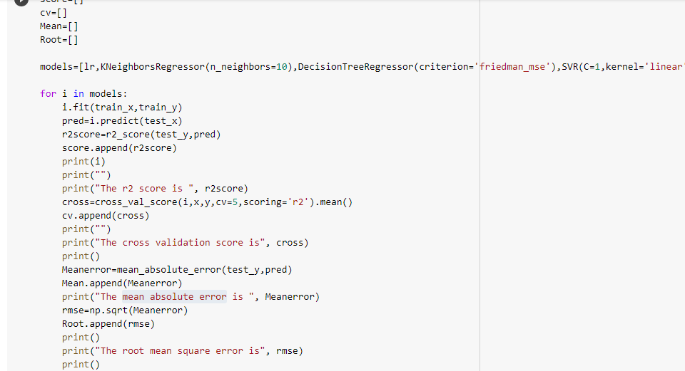
Finding Best Parameters By Using Grid Search CV

Slide 16
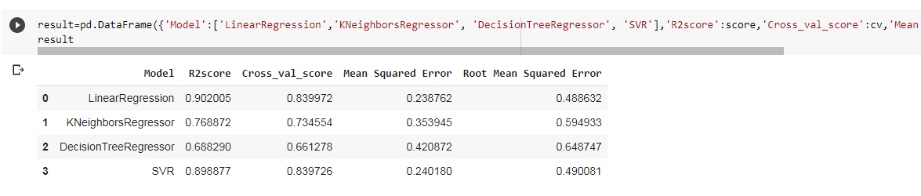
Lets see the results after finding best parameter and applying grid search cv different models

Slide 17
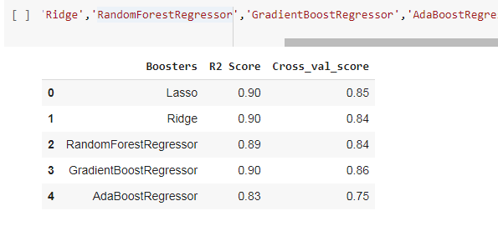
Results of boosting models

Slide 18
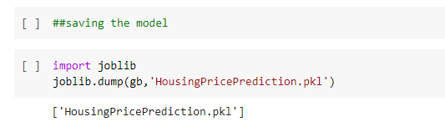
Saving the model

Slide 19
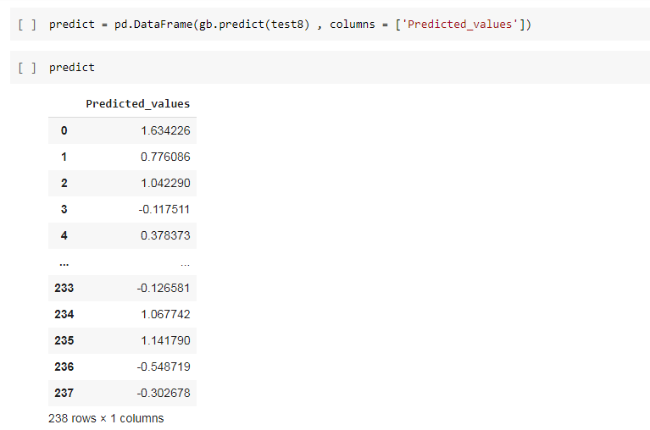
Predictions
1)Using a linear Regression regressor, we can predict with 90.2% accuracy,
2)Using Gradient Boosting regressor, we can predict with 90% accuracy
3)Using a Randon Forest regressor, we can predict with 89% accuracy,
4)Using a K-Nearest Neighbour regressor, we can predict with 76.88% accuracy,.
5)Using a Decision Tree regressor, we can predict with 68.82% accuracy,
6) Using Ada Boost Classifier we can predict with 83% accuracy

